Slide 1


TP de Matériaux MSE-237 Spring 2025
Julie Gheysen
David Hernández Escobar
julie.gheysen@epfl.ch
david.hernandezescobar@epfl.ch

Slide 2
Goals of the TPs
Get acquainted with fundamental material testing and characterization techniques from a practical perspective
Understand the processing-microstructure-property relationships of different materials under various conditions
Perform experiments according to given protocols to collect, organize and analyze experimental data
Write technical reports presenting working procedure, discussing and drawing conclusions from experimental results, showing critical-thinking and referring to underlying fundamentals

Slide 3
Structure of the TPs
7 TP topics
50 enrolled students → 8 groups
(6 groups of 6 students + 2 group of 7 students)
TP | Salle | TA | Email
Chaleur d'hydratation | MXH 016 | Yohann Ansel | yohann.ansel@epfl.ch
Solidification | MXH 915 | Rémy Grillet-Aubert | remy.grillet-aubert@epfl.ch
Traction | MED 3 1523 | David Hernandez | david.hernandezescobar@epfl.ch
Métallographie | MED 3 1420 | Abdellah Abdesselam | abdellah.abdesselam@epfl.ch
Résilience | MED 3 1424 | Gaëtan Denis | gaetan.denis@epfl.ch
Ecrouissage | MED 3 1122 | Sandor Lipcsei | sandor.lipcsei@epfl.ch
Traitements thermiques | MXE 938 | William Le Bas | william.lebas@epfl.ch

Slide 4
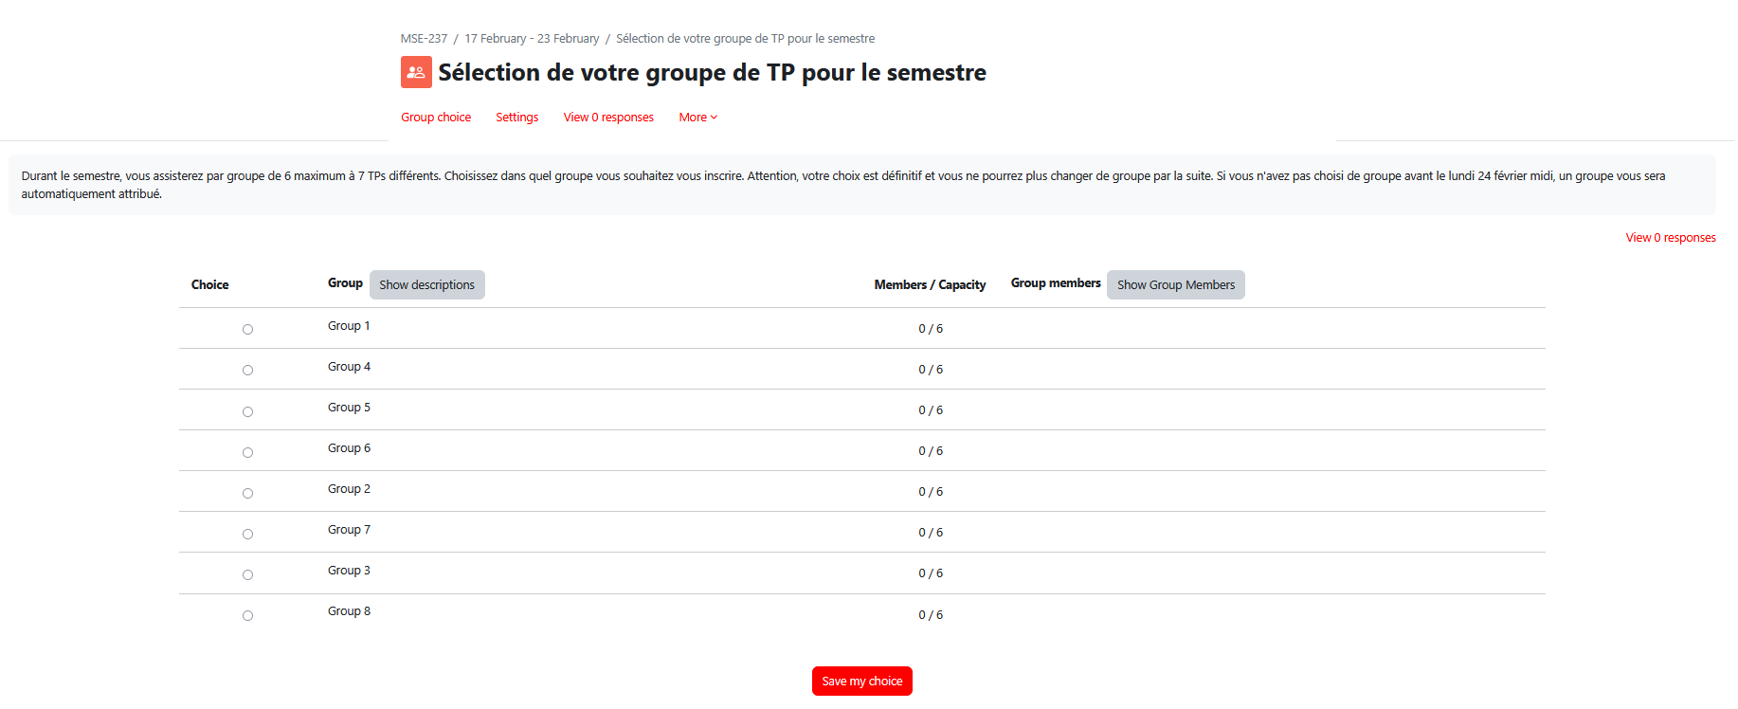
Groups for the TPs
Groups to be formed by yourselves, in Moodle from Feb20 @11am until Feb24 @12pm

Slide 5
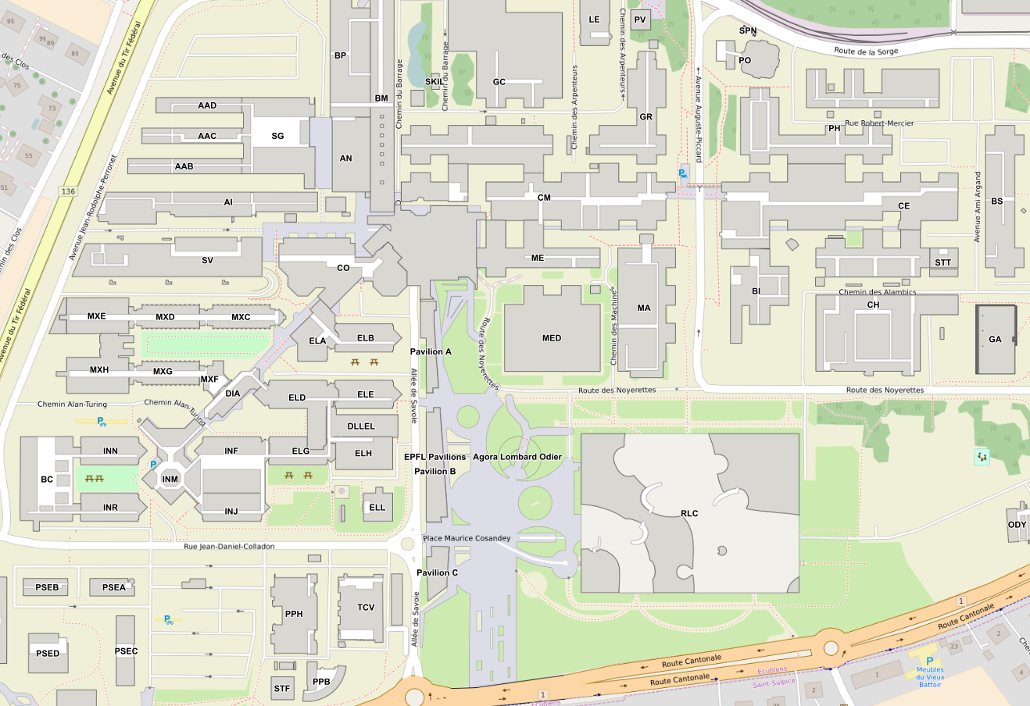
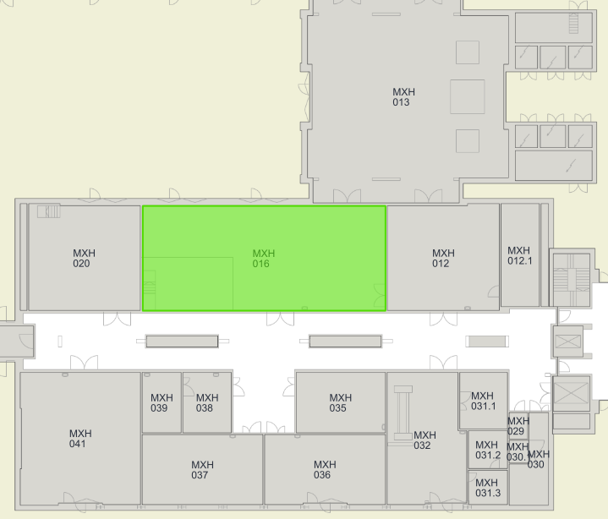
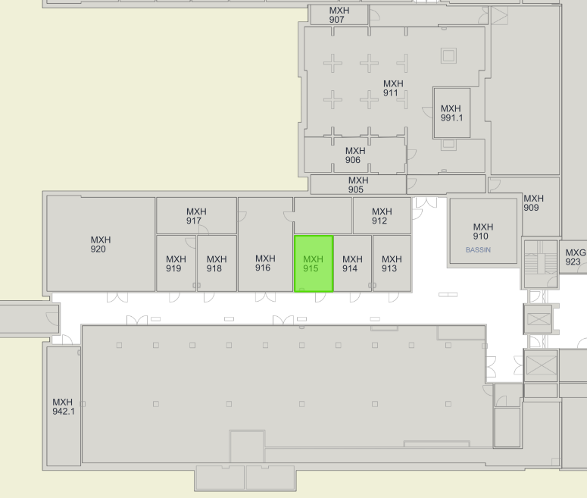
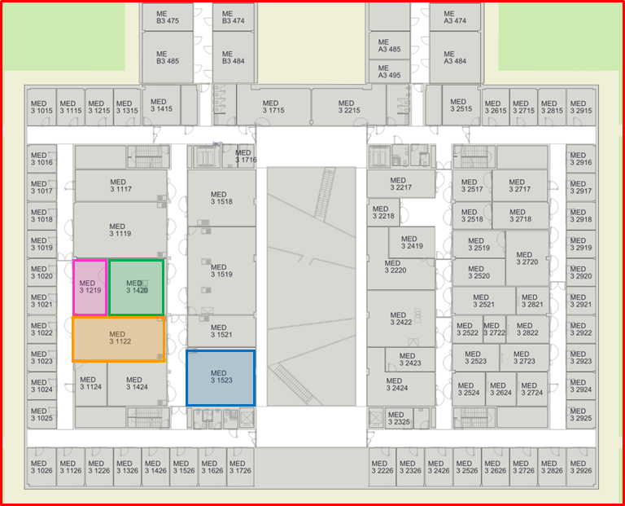
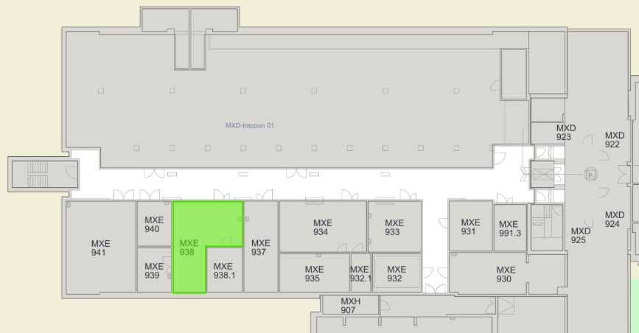
Location of the TP labs
MXH 016:
TP Chaleur d’hydratation
MXH 915: TP Solidification
sous-sol (étage -1)
MED 3 1424: TP Résilience
MED 3 1523: TP Traction
MED 3 1420: TP Microstructures
MED 3 1122: TP Ecrouissage
MXE 938: TP Traitements thermiques
sous-sol (étage -1)

Slide 6
Schedule of the TPs
TP sessions will be held on Thursdays from 9:15-12:15h
Red time slots: no TP scheduled but kept as back-up if rescheduling is necessary
Other time slots: will be filled with group numbers and published in Moodle after group formation on Feb.24 afternoon
Experimental work may take up to 2.5h, the remaining time is meant to start organizing the written TP group report
 |  |  |  | FÉVRIER | MARS |  |  |  | AVRIL |  |  | MAI
TP | Salle | TA | Email | 27 | 6 | 13 | 20 | 27 | 3 | 10 | 17 | 1 | 8 | 15 | 22
Chaleur d'hydratation | MXH 016 | Yohann Ansel | yohann.ansel@epfl.ch
Solidification | MXH 915 | Rémy Grillet-Aubert | remy.grillet-aubert@epfl.ch
Traction | MED 3 1523 | David Hernandez | david.hernandezescobar@epfl.ch
Métallographie | MED 3 1420 | Abdellah Abdesselam | abdellah.abdesselam@epfl.ch
Résilience | MED 3 1424 | Gaëtan Denis | gaetan.denis@epfl.ch
Ecrouissage | MED 3 1122 | Sandor Lipcsei | sandor.lipcsei@epfl.ch
Traitements thermiques | MXE 938 | William Le Bas | william.lebas@epfl.ch

Slide 7


What do you need for the TPs?
Punctuality. Be at the TP lab assigned at 9h15 (respect everyone’s time)
Read and understand the TP protocols uploaded to Moodle in advance
Usual lab material: notebook, laptop, calculator…to take good notes during the TP
USB drive to export TP experimental data, and spreadsheet sofware (i.e. Microsoft Excel) to analyze it
Personal protective equipment (lab coat, gloves, safety googles…) will be available in the lab, if needed
Positive attitude and team work! ☺
NO sandals, shorts, skirts, food, drinks are allowed in the lab and long hair must be tied up. If these safety rules are not observed, you will be excluded from the TP.

Slide 8
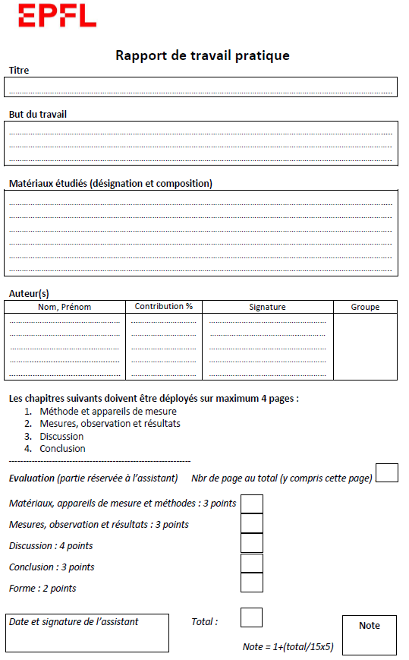
TP reports
Front page to be filled and attached to the beginning of each report
(Word template in Moodle)
4 pages maximum in addition to the front page (font size 11 or higher; single spacing)
Written in English or French

Slide 9
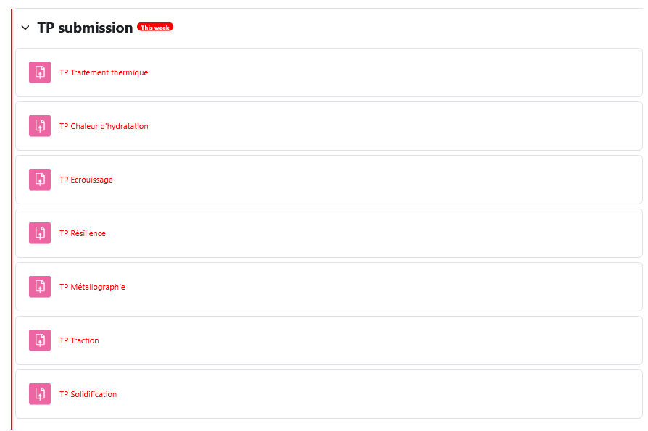
TP reports
To be submitted in Moodle, in PDF format.
Submission deadline:1 week after the TP session (i.e. next Thursday before 12:15) (-0.25 for each day of delay)
Reports will be scanned to check for plagiarism (do not share experimental data among groups)

Slide 10
How will you be evaluated? (i)
Each TP report will be assigned a grade within the 0-6 scale, in 0.25 intervals
Each TP report front page must contain: name, signature AND contribution% of each group member.
Students are expected to contribute equally to the report writing (i.e. 20% contribution per student for a group of 5 students)
Example 1 – report grade: 4.75/6
Example 2 – report grade: 4.75/6
Student | Contribution to the report (%) | Contribution to final course grade
A | 20 | (1/7)*(20/20)*4.75
B | 20 | (1/7)*(20/20)*4.75
C | 20 | (1/7)*(20/20)*4.75
D | 20 | (1/7)*(20/20)*4.75
E | 20 | (1/7)*(20/20)*4.75
Student | Contribution to the report (%) | Contribution to final course grade
A | 15 | (1/7)*(15/20)*4.75
B | 15 | (1/7)*(15/20)*4.75
C | 25 | (1/7)*(25/20)*4.75
D | 25 | (1/7)*(25/20)*4.75
E | 20 | (1/7)*(20/20)*4.75
Final course grade will be the sum of your contributions over the 7 TP reports, computed as per the above examples.
If your contribution % in the TP report is less/more than your colleagues, your TP grade will be lowered/increased proportionally.
Final TP grades for each student will be capped at the maximum grade in the TP report

Slide 11
How will you be evaluated? (ii)
TP grade (6/6) will consist of:
Attendance (1/6): +1 / 0 / -1
+1: on time and active participation
0: late arrival or passive presence
-1: arrival after start of the TP, unnotified absence or disturbing presence
Report (5/6)
TP reports will be corrected and graded by the corresponding TA
Only a written feedback will be sent to students (but NOT the grade, as per article 19 of the EPFL Ordinance on study evaluation (Lex 2.6.0.1) EPFL) before the following TP report is due.

Slide 12
How to write a good scientific report
Quality better than quantity!
Comprehensive, descriptive and rigorous content (ensure reproducibility and measurement error analysis)
Organized structure in the following sections:
Materials and methods
Results
Discussion
Conclusion
Sub-sections are welcomed to organize the report more clearly
Numerical results must include measurement errors (error propagation)
Form (writing style + formatting) should be technical, consistent and concise
All figures and tables presented must be cited in advance in the text
Label figures (at the bottom) and tables (on top)
Answer the questions asked (if any) in a rigorous way
Mention also unsatisfactory results, encountered problems, and propose possible explanations.
Information to be included in each section is detailed in Moodle

Slide 13
Absence in a TP
If you cannot attend a TP session (for an extraordinary reason described by EPFL law), you need to notify and justify your absence with the required supporting document in advance to Julie and David, by email.
ONLY if the absence is properly justified, it will be approved and a new date to retake the TP (with a different group) will be communicated.
«If you are unable to take a test during the semester (or to submit a test within the imposed deadline in the case of a project, report, poster, etc.), you must get in touch with the teacher in charge of the subject before the test (or the due date when applicable) and provide him with a valid medical certificate covering the date in question (or a copy of your child’s birth certificate or a direct relative’s death certificate) soon afterward. As much as possible, the teacher will then need to give you a chance to take the test at a later date during the same semester. »
https://www.epfl.ch/education/studies/en/rules-and-procedures/faq/registering-courses-exams-withdraw/

Slide 14
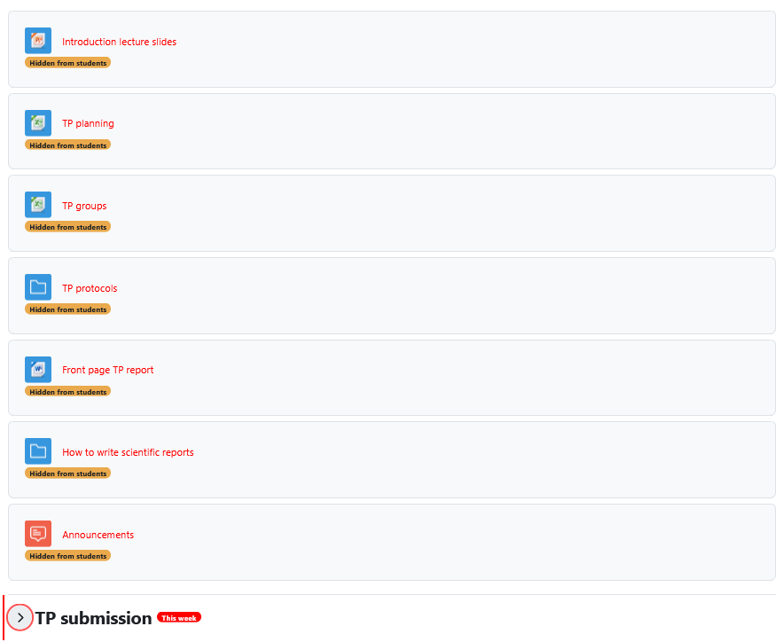
Course Moodle

Slide 15
What do previous students say about the course?
“ Mon cours préféré ce semestre. Il est en totale adéquation avec le cours de Métaux et Alliages ce qui permet de mieux comprendre et de le voir pour de vrai. Les assistants étaient tous motivés et motivant ce qui rend les TP encore meilleurs”
“ Cours/TPs intéressants qui permettent de bien acquérir des notions vues dans le cours métaux et alliage avec une petite aparté intéressante sur le béton. ”
“ Les TP sont absolument nécessaires dans ce semestre. J'ai l'impression que c'est lors des TP que j'ai le plus appris pendant le semestre. Ils ont également fortement aidé à comprendre le cours de Métaux et Alliages. J'ai apprécié l'adaptation faite suite aux évaluations faites après quelques semaines de cours. Les feed-backs sur les TP étaient très utiles. ”
“Absolutely brilliant of a course, learnt so much and helped a lot of learning and making connection with the knowledge learnt in other subjects such as Metal and Alloys. All the TAs explain the theory very well and through the writing of the report, it allows us to work as a team and verify that we have well understood the courses”

